Slide 1

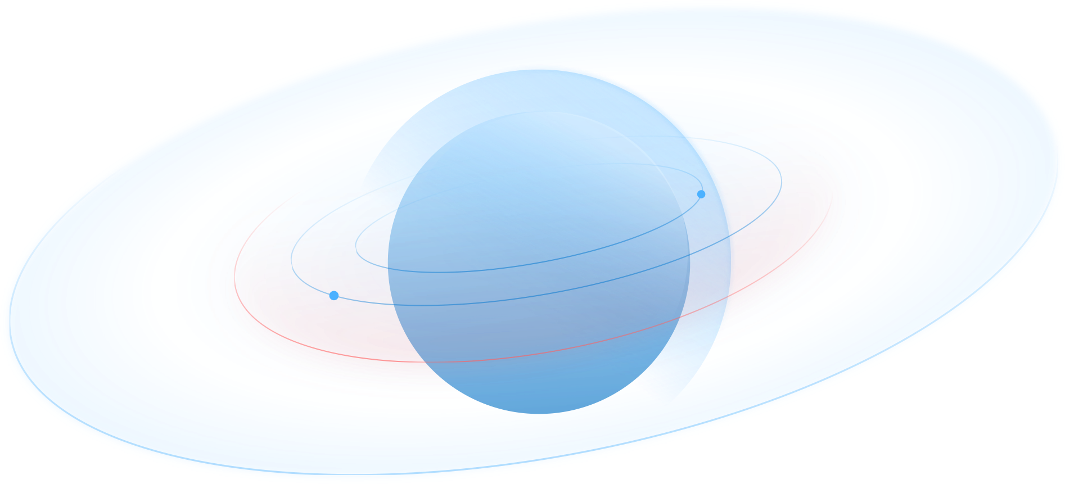



Decentralized OTC
Meet the partners

Slide 2

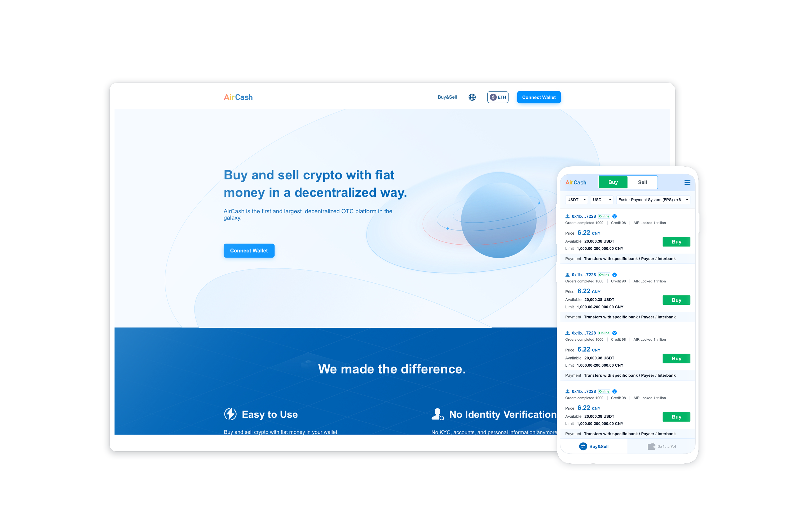

What’s AirCash
AirCash is the first and largest decentralized P2P trading platform in the galaxy.
Buy and sell crypto with fiat money in a decentralized way.
2

Slide 3
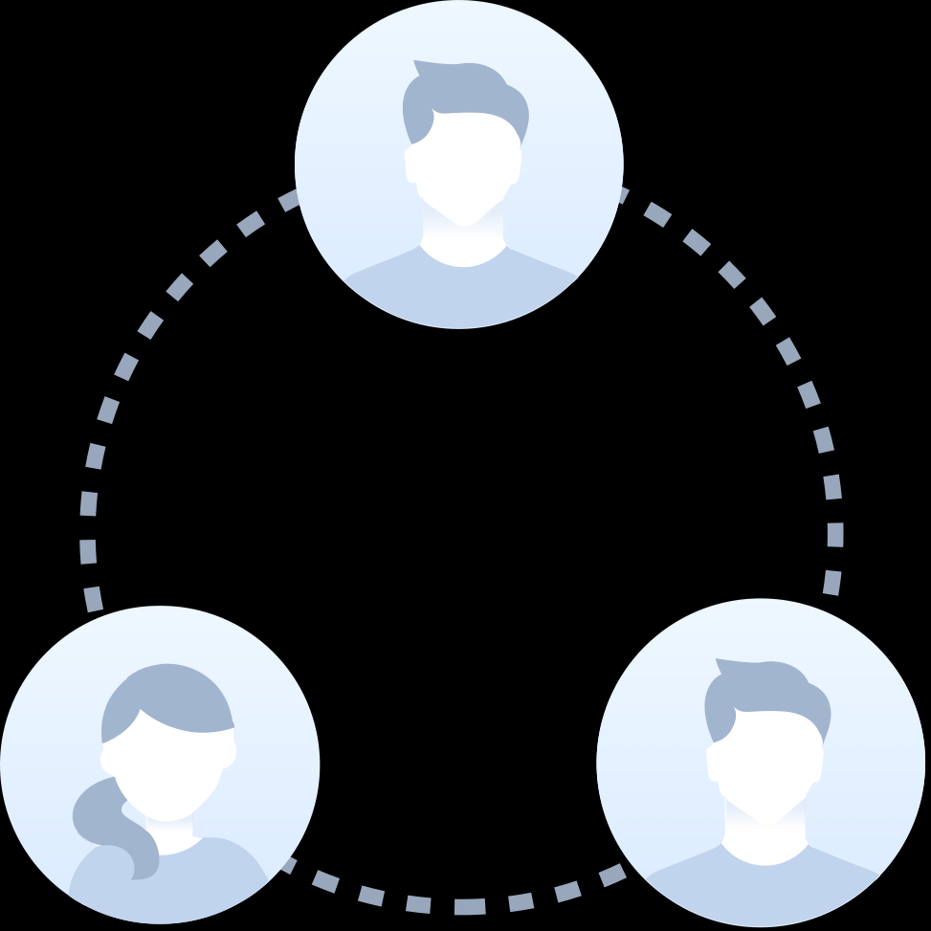
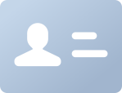
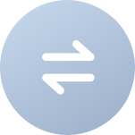

What’s the problem
It’s ridiculous that we all need KYC to do anything in Crypto.
It’s ridiculous that we all need a centralized crypto exchange for cash in and out.
3

Slide 4






Why AirCash
Easy to Use
No Identity Verification
Buy and sell crypto with fiat money in your wallet.
No KYC, No accounts, and No personal information anymore.
You don’t need any exchange anymore.
You can buy and sell anonymously.
Secure & anonymous
Decentralized
Traders get in touch through a peer-to-peer messager.
All trading takes place on the blockchain.
No one knows the details of your trading.
We have built a DAO for decentralized governance.
4

Slide 5


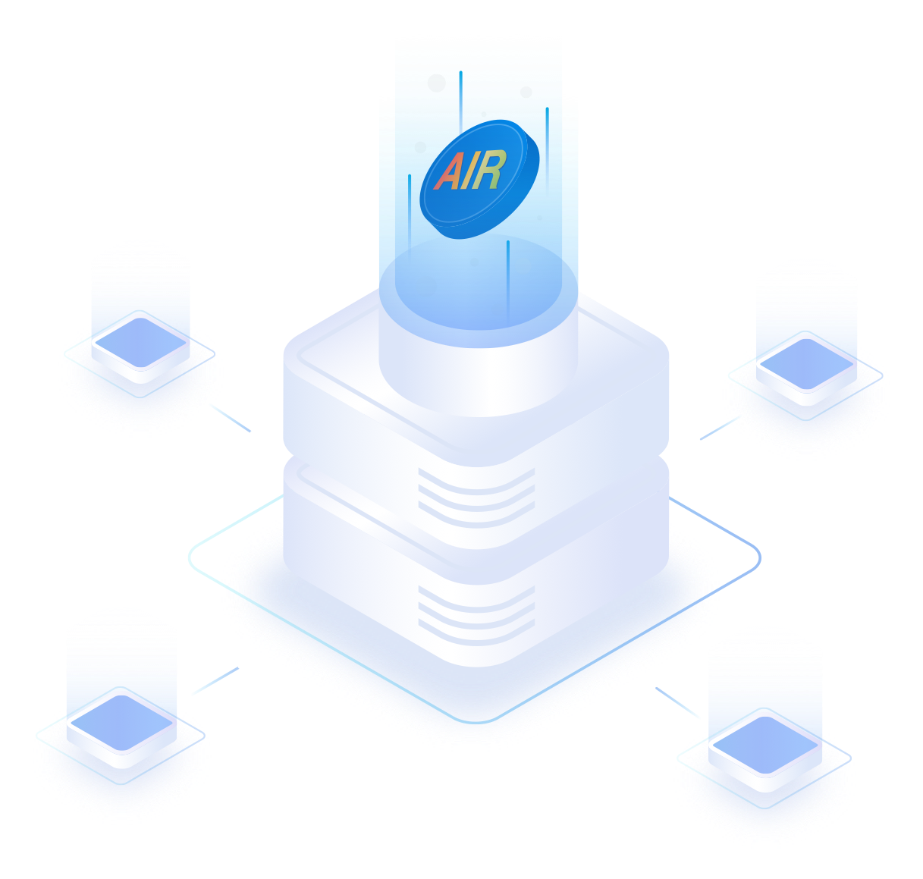
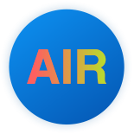

What's the nomic
AIR is the ECO token of the AirCash system.
1. AIR token
10,000 trillion AIR hard cap.
9,555 trillion AIR burnt.
50 trillion AIR and 200 BNB are added for PancakeSwap liquidity.
395 trillion AIR was locked by an AIRNFTmining smart contract.
5

Slide 6
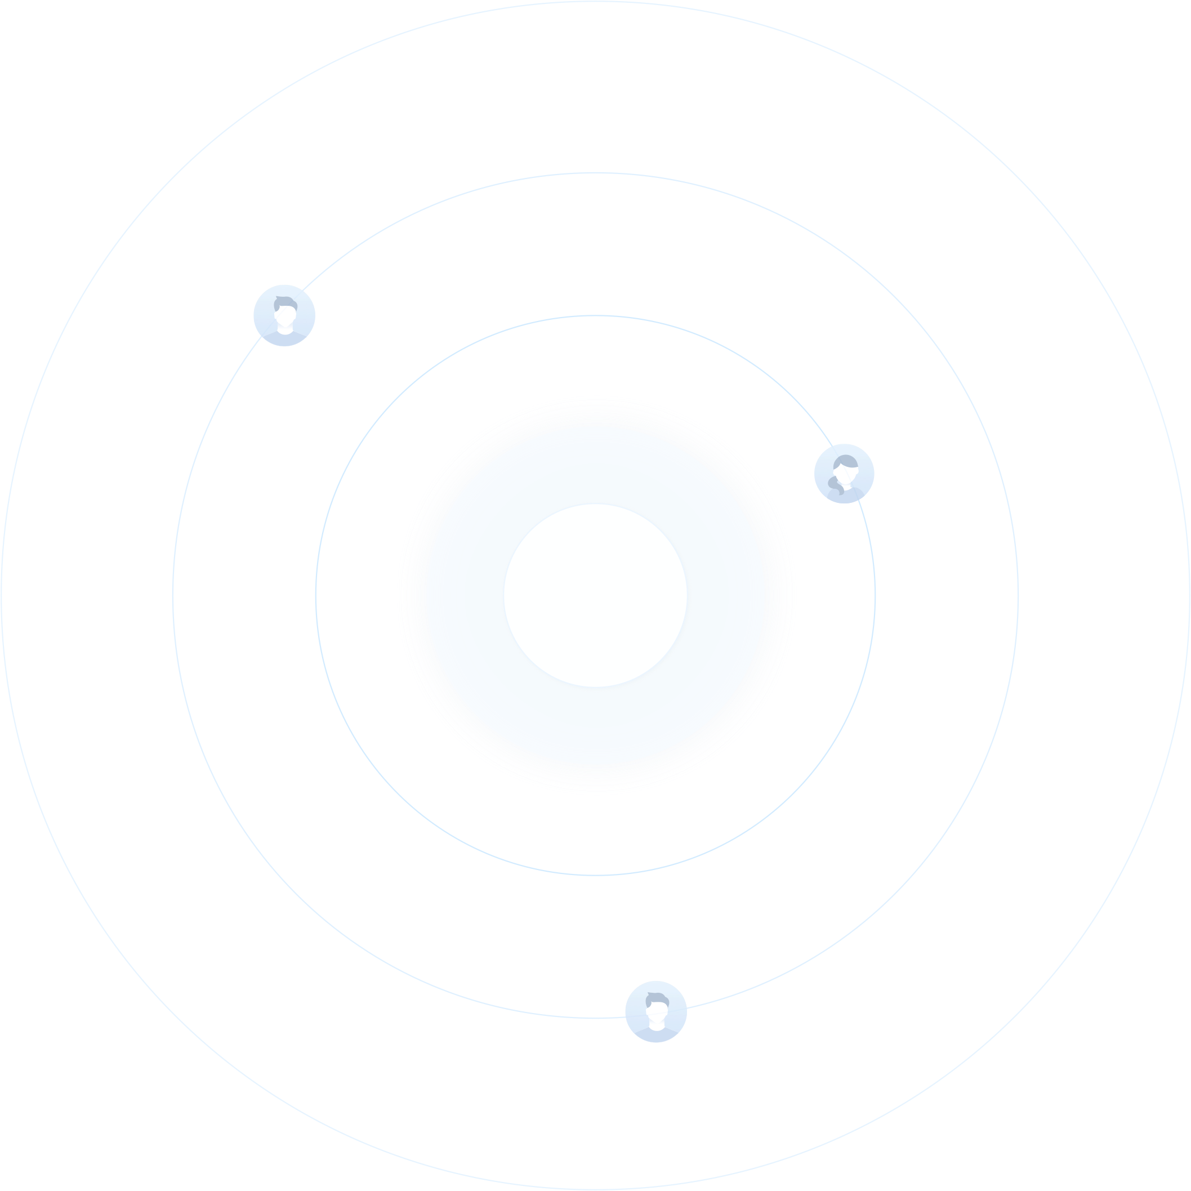

What's the nomic
AIR is the ECO token of the AirCash system.
2. AIRNFT mining
395 trillion AIR was to be distributed to the Qualified Old AIR Holders(QOAH).
Every QOAH will receive an NFT.
Every QOAH can claim less than 1% AIR from an AIRNFTmining smart contract every month.
The release ratio of the first 12 months is 1% per month, and the release ratio will behalf every 12 months.
The final circulating supply will be less than 450 trillion.
6

Slide 7


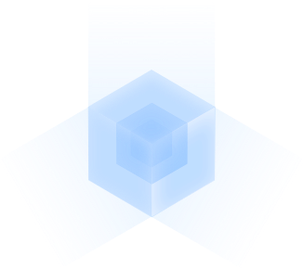

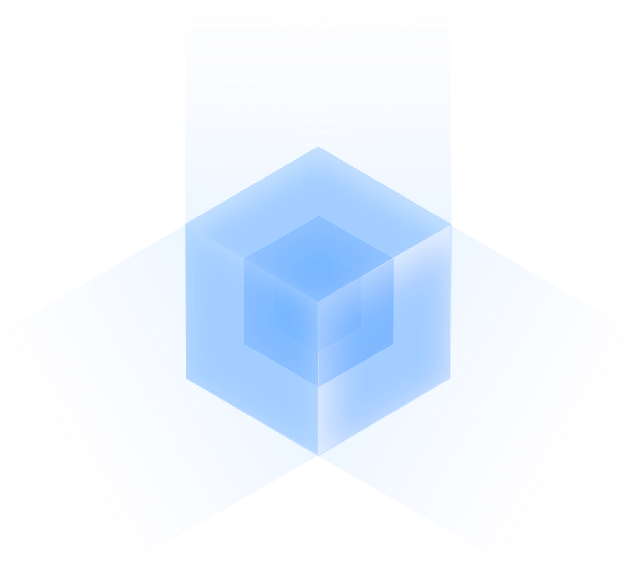


Safety
Audit
AirCash's smart contract will be audited by Certik and SlowMist.
Certik: https://www.certik.com
SlowMist https://www.slowmist.com
Security & Privacy
Traders get in touch through a peer-to-peer messager.
No one knows the details of your trading except yourself.
No super admin key
The assets are fully locked with the smart contract.
There is no super admin key, and no one can take away the assets in the smart contract.
7

Slide 8
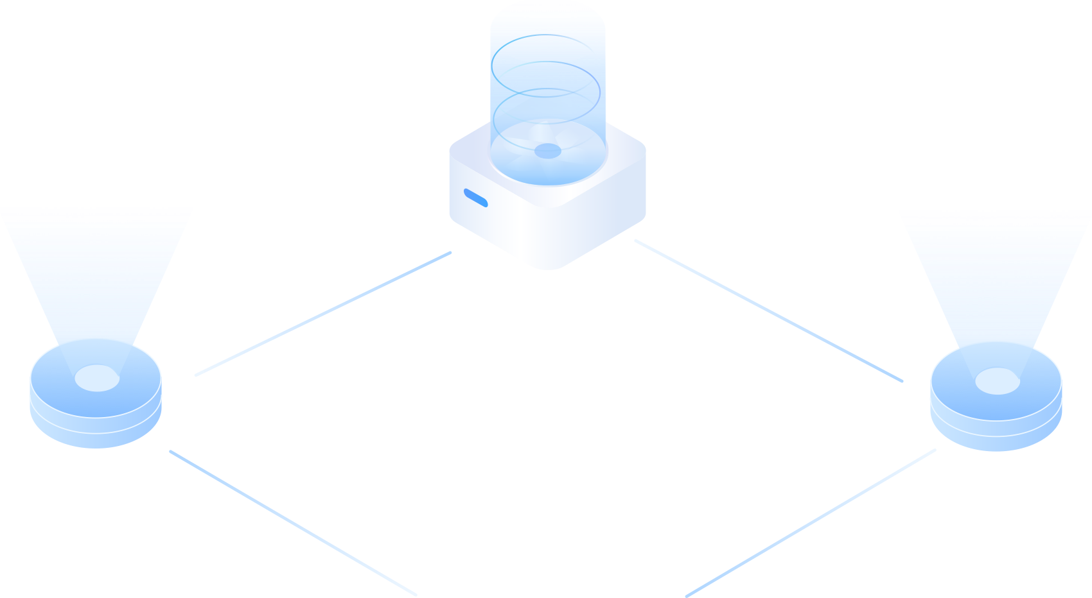




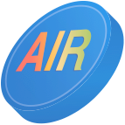


Decentralized governance
Merchant
Merchants need to lock 10 billion AIR.
The merchant is the liquidity provider of the system.
Witnesses
Witnesses need to lock 100 billion AIR and pass the assessment.
The witness needs to deal with the appeal.
For each appeal, the witness can get 1 USDT or 1 million AIR.
8

Slide 9


Decentralized governance
Members of Congress
Congress Members need to lock more than 1,000 billion AIR and pass the assessment.
When someone disagrees with the judgment of the witness, they can appeal to congress, and the congress members
need to make the final judgment.
For each appeal, the Congress member can get 10 USDT or 10 million AIR.
DAO and the referendum
AIR holders need to elect 5 congress emembers every 6 month.
9

Slide 10









More Info
Website: https://aircash.finance
Twitter : https://twitter.com/aircoinreal
Discord: https://discord.gg/aircash
Telegram: https://t.me/aircoinrealchannel
YouTube link: https://www.youtube.com/channel/UC-20apMTQfvwG9NB2R0sIOQ
AirCoin DAO Labs
AirCoin DAO Labs is a decentralized autonomous Organisation.
We have built ACG Ventures, AIR token, AIRNFT, and AirCash.
ACG Ventures
ACG Ventures is DAO-based venture capital.
10

Slide 11

More Info
AIR Token
AIR was issued to mock the madness of the cryptocurrency market.
If you buy AirCoin, you get nothing but AIR.
AIRNFT
AIRNFT is an asset-based NFT project.
You can claim AIR tokens from a mining contract with your AIRNFT.
AirCash
AirCash is the first and largest P2P crypto trading platform.
11

